Slide 1


Developing mediation skills:
Note-taking
Guided Tours
Lesson 2

Slide 2
In this lesson we’re going to
discuss your notes of two audio guides
use ‘information units’ to help you improve your notetaking
share information in pairs using your notes
discuss criteria of a good summary
produce a summary of the tour guide’s commentary

Slide 3
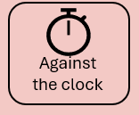
Group work
Make groups of 4 or 5. Students A work together, and students B work together.
In groups, compare your notes and agree on the number of information units.
Then, use the list of I.U.s to check your notes and score yourselves.

Slide 4
In pairs share the information
Make pairs of student A and student B.
Student A: tell student B what your tour commentary is about.
Student B: tell student A what your tour commentary is about.
Use your notes when you are talking. Take notes when you are listening.
-----------------------------------------------------
You can come back to the expert groups and share what you learnt.

Slide 5
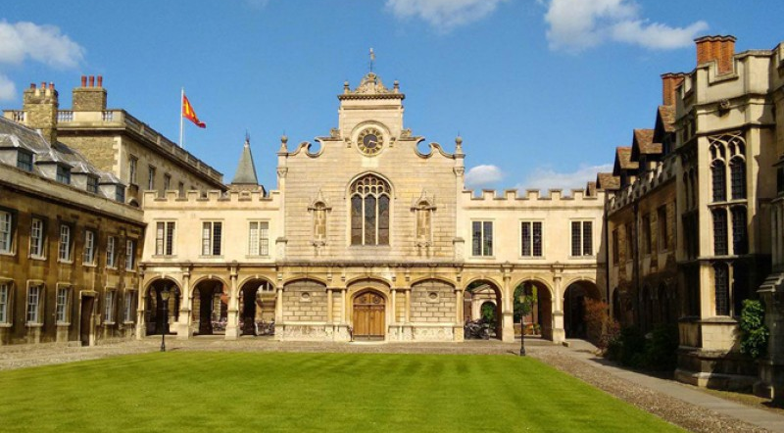
Notes:
The next 4 slides and just for fun, and to provide context. Where is this? Is it Vilnius University? How can you tell? We’ll be listening to a tour guide commentary about it. Let’s see if you can understand him
What do you know about it? (speculate, don’t provide info)
(if they don’t know don’t tell them it’s Peterhouse College, Cambridge

Slide 6

Notes:
Where’s this? Vilnius University
What do you already know about it? Brainstorm, list what they already know. If they know nothing that’s fine, just move on

Slide 7
Mark the transcript (Lesson 1)
Main ideas
Supporting ideas
Transitions
Examples
Redundant elements

Slide 8
Use of notes
In what situations do you think notes can be very helpful?
What are the features of a good summary?
Notes:
You introduced them to the 5Cs in lesson 2 of the summarising unit: Social Media.
If so, you can use this to briefly review and then user the next slide to remind them of the 5Cs.
If you haven’t introduced the 5Cs before then ask them to brainstorm and then introduce the 5Cs

Slide 9
A good summary should be …
The 5Cs of summarising
Complete: | A good summary is complete. It includes all the key points.
Concise: | A good summary is concise. It is within the word limit, usually ⅓ (or ½) , which depends on the length of the original text and the purpose of summarising.
Clear: | A good summary is clear. It is well-organised and easy to understand.
Creative: | A good summary is creative. It paraphrases the original text well, simplifying and avoiding repetition.
Correct | A good summary is correct. It uses a good range of and makes few vocabulary, grammar, punctuation or spelling mistakes.
Notes:
Let’s start by reviewing what makes a good summary.
In EAP course books, there are the 5Cs of a good summary. We’ve added a 5th C: correct because exams assess linguistic accuracy.
The 5Cs table is set to ‘appear’, so first ask them to brainstorm the features of a good summary, and then introduce the 5Cs. You could tweak the Cs if you want, by highlighting that “creative” doesn’t mean what we usually understand as “creative”. It means no more than using your own words, so we could say 4Cs and a P (for paraphrase) ☺

Slide 10
Summarising
Write a summary of the tour guide’s commentary in c. 120 words, using your notes to help you.
Notes:
You introduced them to the 5Cs in lesson 2 of the summarising unit: Social Media.
If so, you can use this to briefly review and then user the next slide to remind them of the 5Cs.
If you haven’t introduced the 5Cs before then ask them to brainstorm and then introduce the 5Cs

Slide 11
Review and reflections
How interesting was this lesson and the previous lesson on note-taking?
How useful was it?
How difficult was this lesson?
What one thing would you like to improve?

Slide 12
How well can you take notes while listening?
I can do it …
… easily and very well | +4
… quite easily and quite well | +3
… with difficulty but OK | +2
…with difficulty and badly | +1
I can’t do it. | 0
I don’t know. I never tried | ?
Notes:
This is a simple pre-test, to give the Ss the opportunity to think about whether they can do it and how well.
Read the can-do statement and give them a moment to note their score.
NB don’t forget to return to this at the end of the lesson

